Slide 1
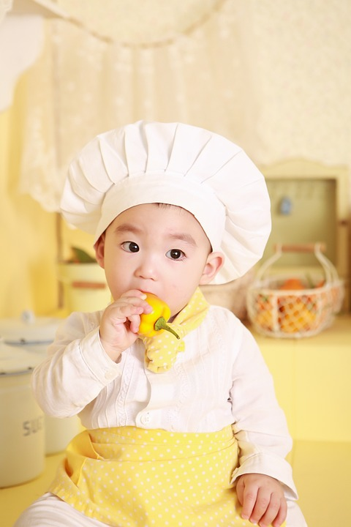
Food around Asia
Matrix
Kite
William
Lucy
Phoo Pwint

Slide 2
CHINESE FOOD

Slide 3
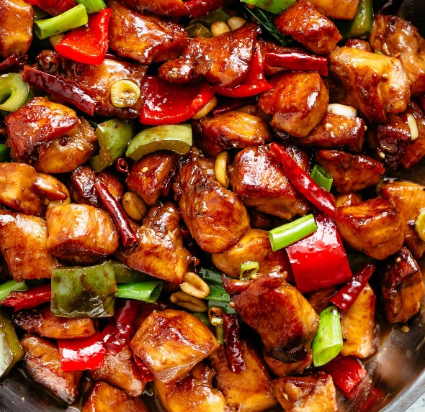
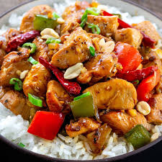
Kung Pao
Chicken
Ingredient
It is made with stir-fried chicken mixed with Sichuan pepper corns, peanuts, chili and bell peppers.
Named after DingBaozhen, governor of Sichuan Province. His title was Gongbao.

Slide 4
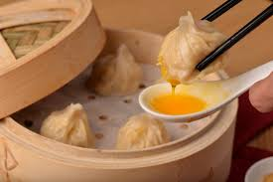
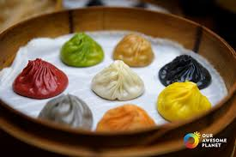
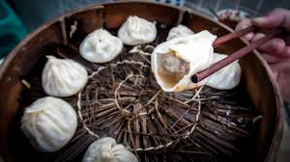
XIAO LONG BAO
Ingredient:
Steamed bun with meat fillings and spicy soup.
Eat with ginger sauces.
Feel the burning and explosion flavor.
It is a type of Chinese steamed bun from Jangnan region

Slide 5

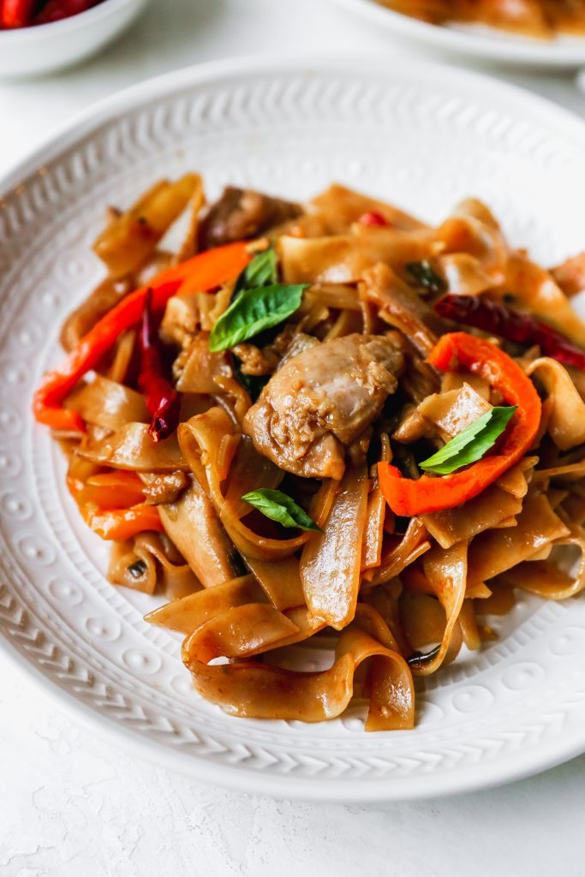
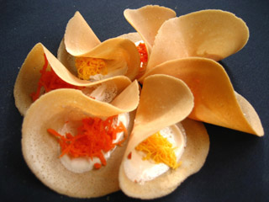
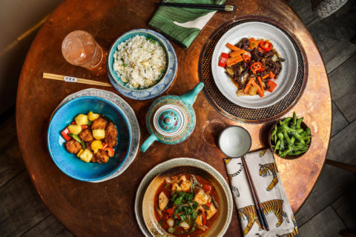
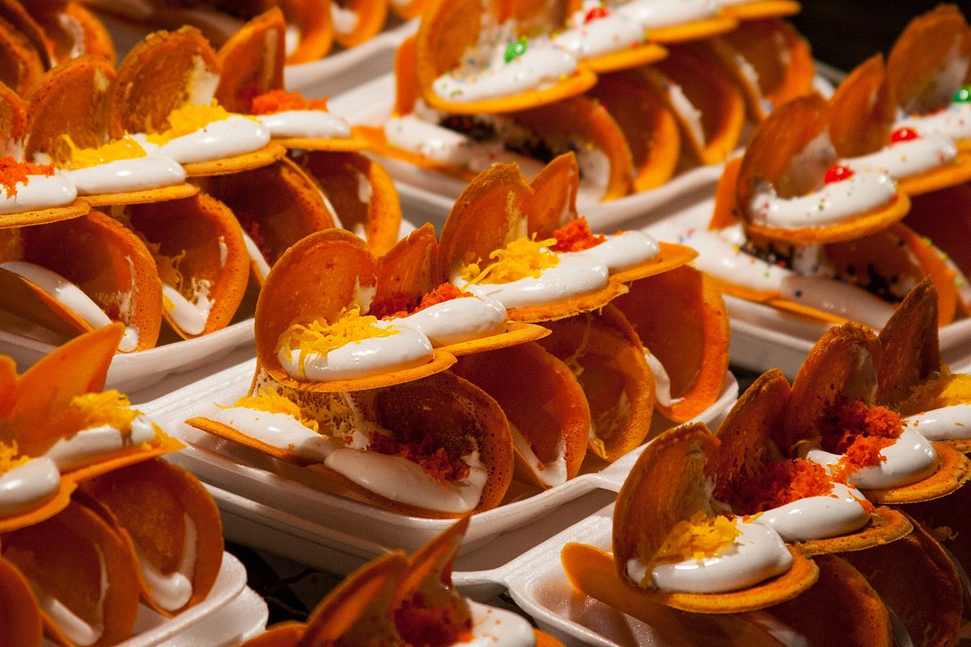
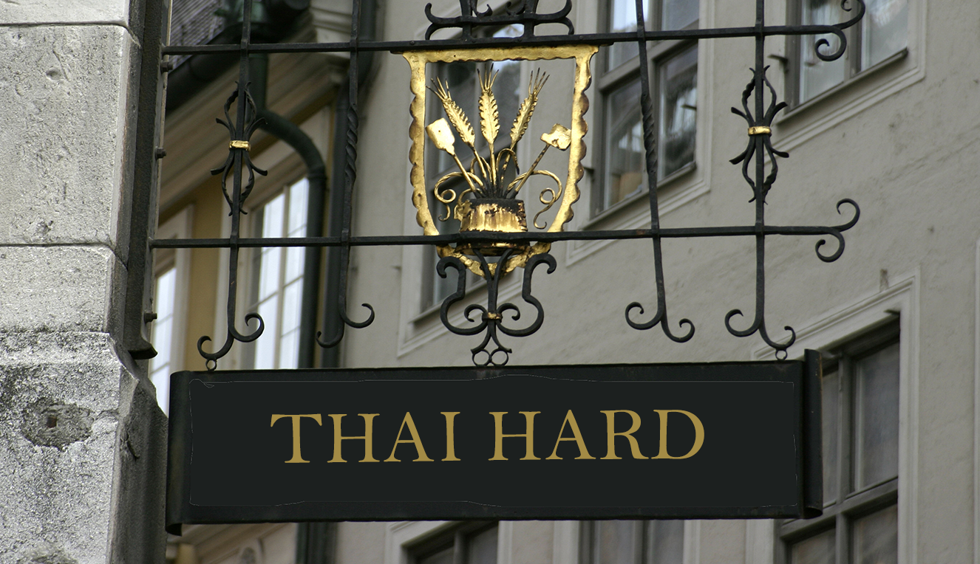
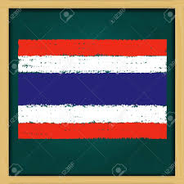
THAI FOOD

Slide 6

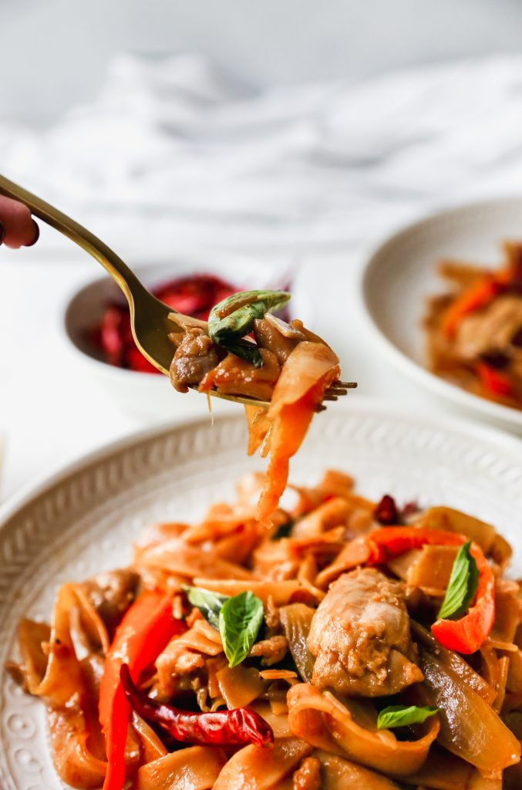
Drunken Noodles
Known as Pad Kee Mao
Spicy enough to make you feel drunk
Taste : Surprisingly thick creating a rubbery chewy texture

Slide 7
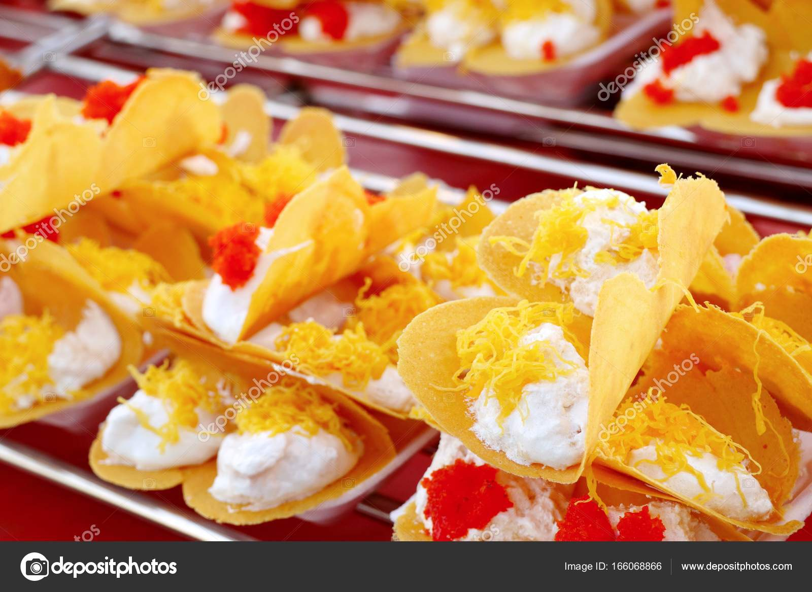
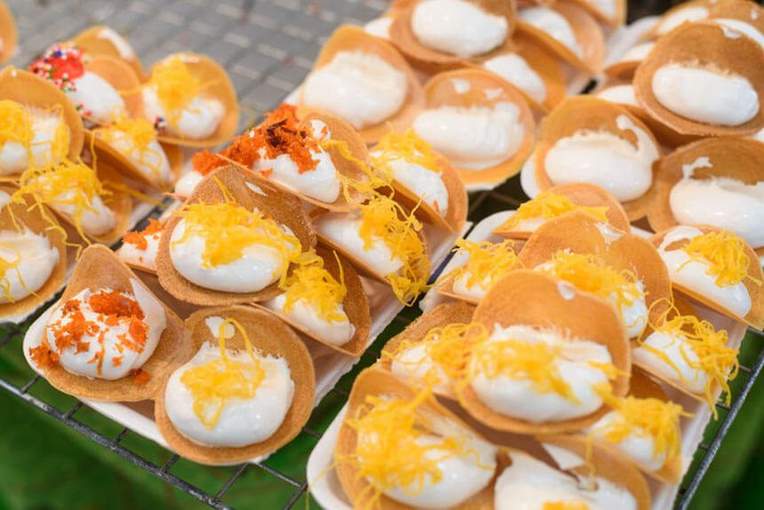
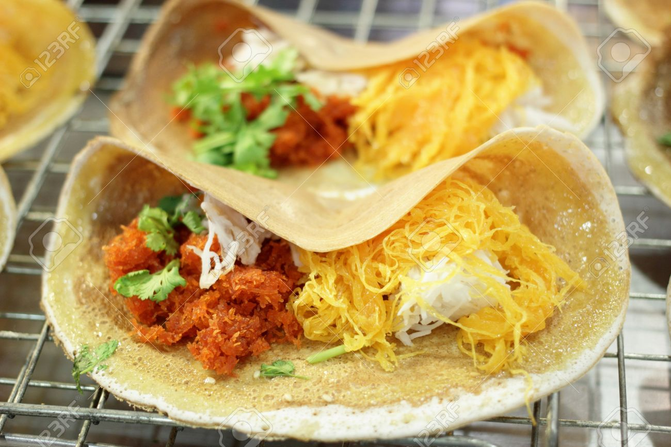
Thai Crispy Crepe
Also called Khanom Buang
Taco looking snack with crunchy texture
Pancake batter stuffed with sweet or savory cream

Slide 8
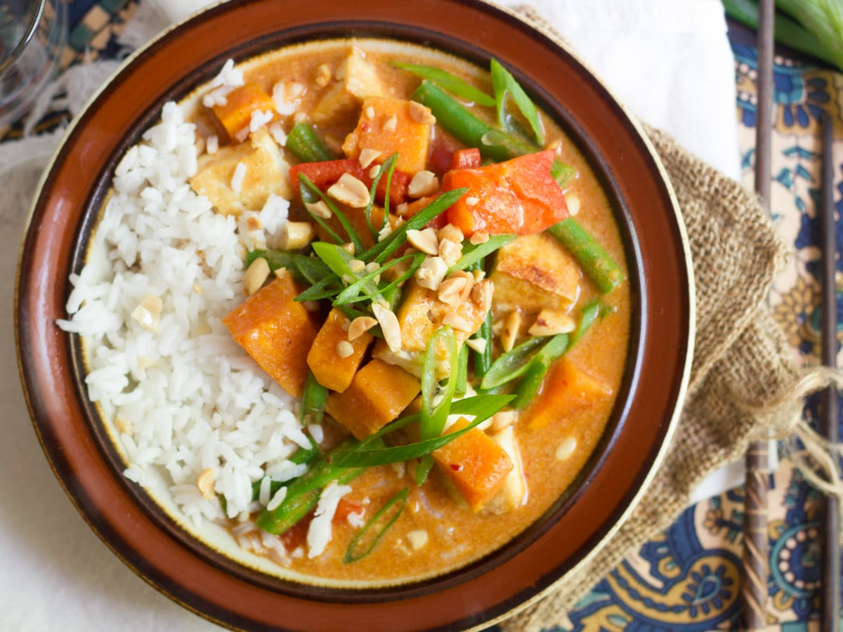
Massaman curry
Rich , relatively mild Thai curry
Has Persian influence and originated in the south of Thailand
Derived from Indian curry

Slide 9
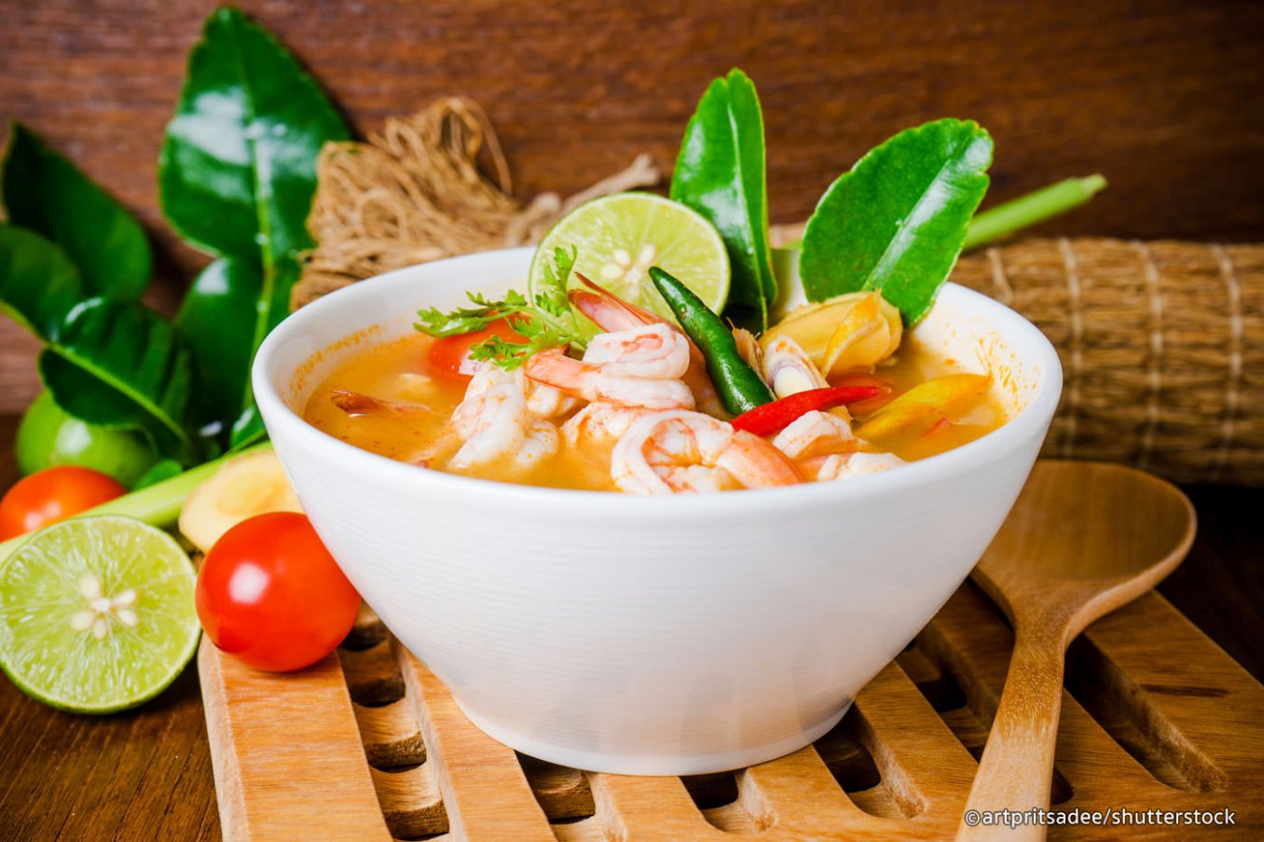
Tom yum goong
spicy shrimp soup
Most famous Thai soup
Very healthy
Reduces heart disease , increases immunity and relieves coughing and nausea

Slide 10
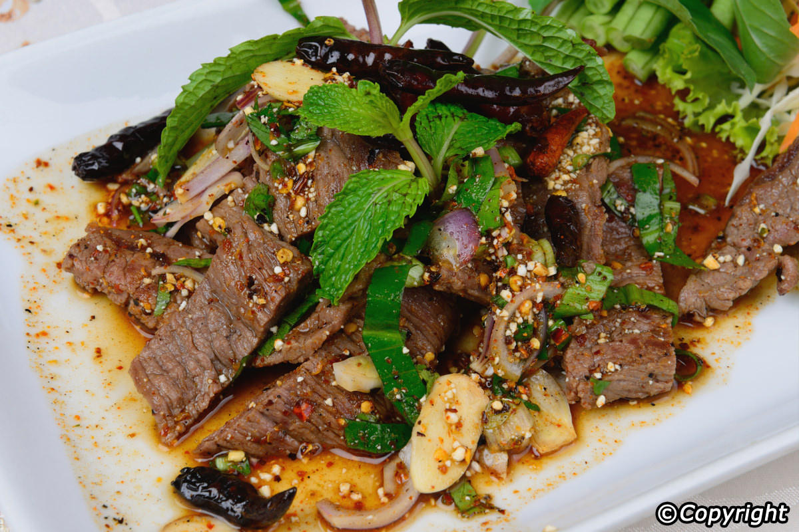
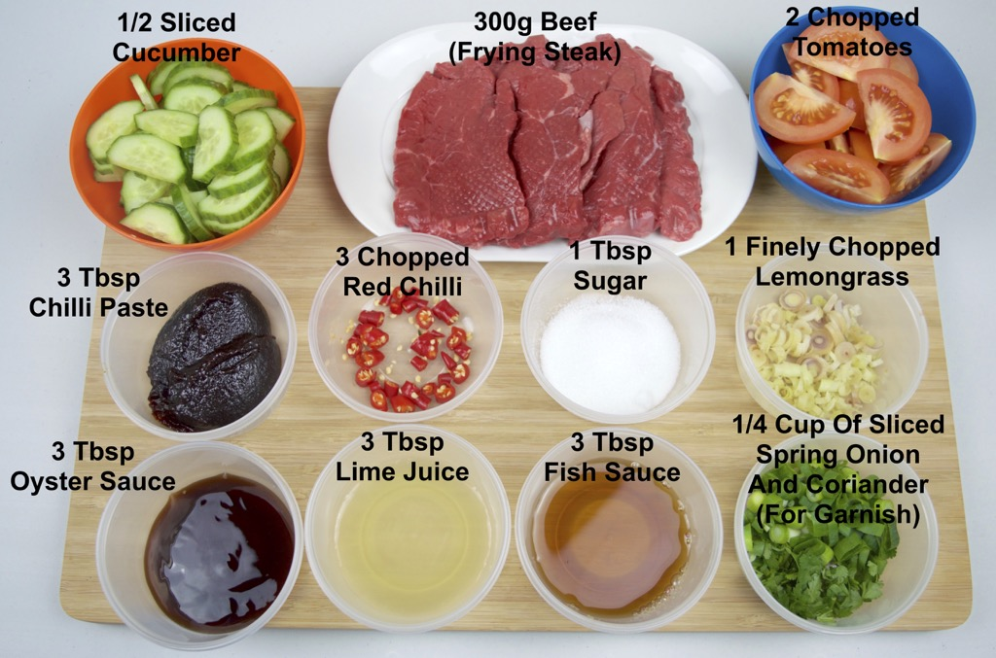
Yum Nua
Thai Beef Salad
Best served with jasmine rice or sticky rice to soak up the sauce
Can also eat as quick light snack

Slide 11
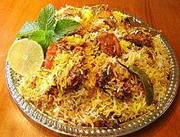
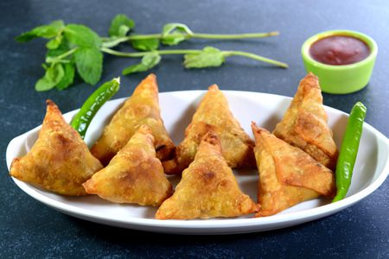
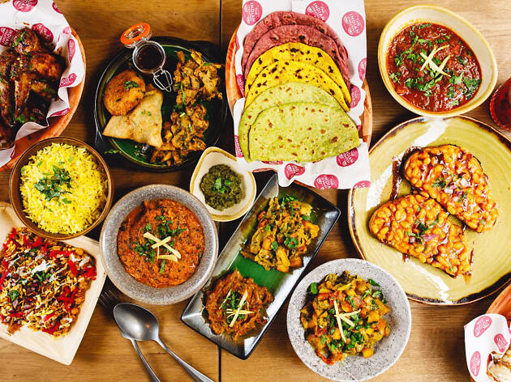
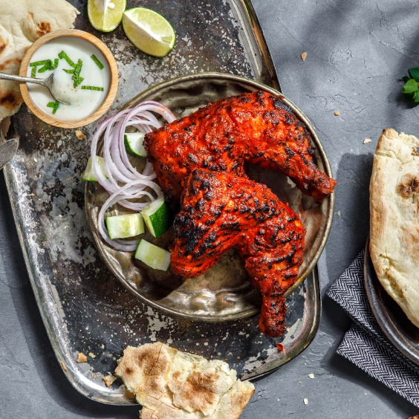
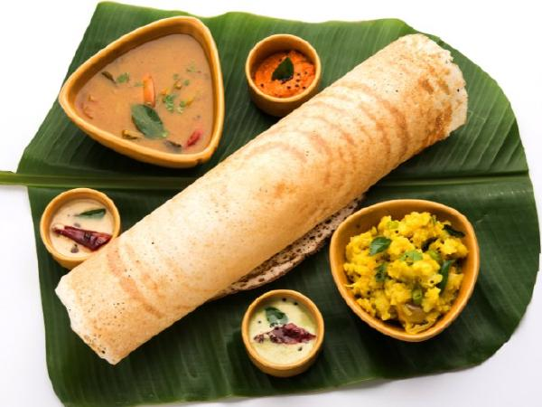
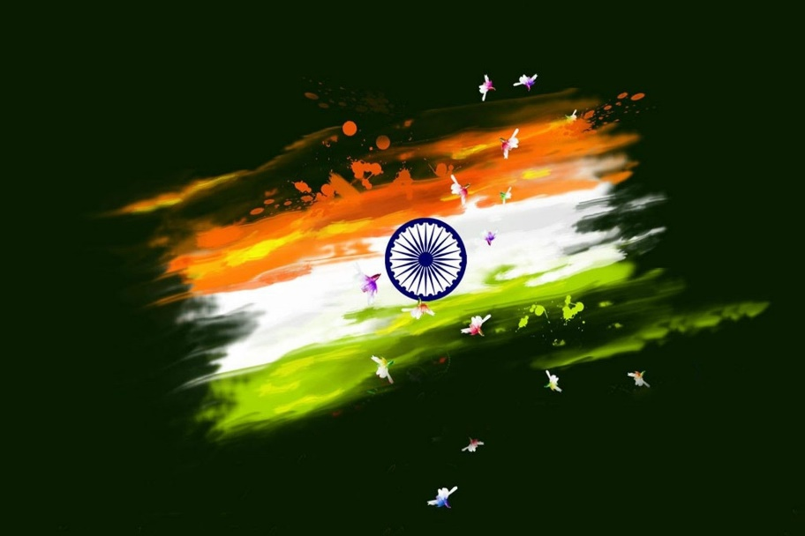
Indian Food

Slide 12
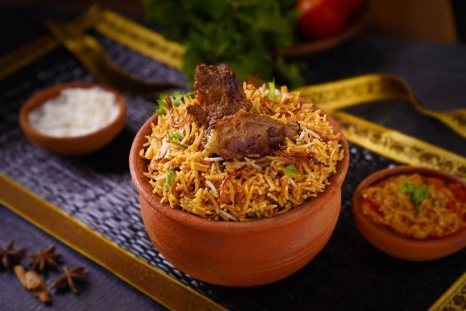
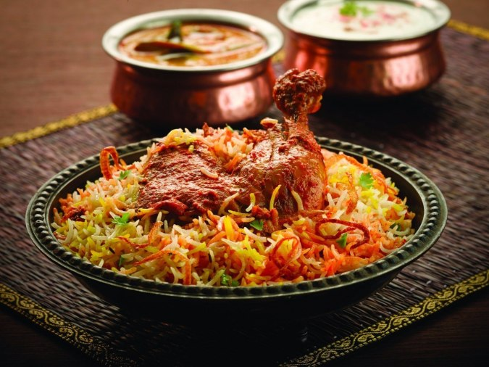
Biryani
-is a mixed rice dish with its origins among the Muslims of the Indian subcontinent.
Ingredients
It is made with Indian spices, rice, meat (chicken, goat, beef, lamb, prawn, or fish), vegetables or eggs.

Slide 13
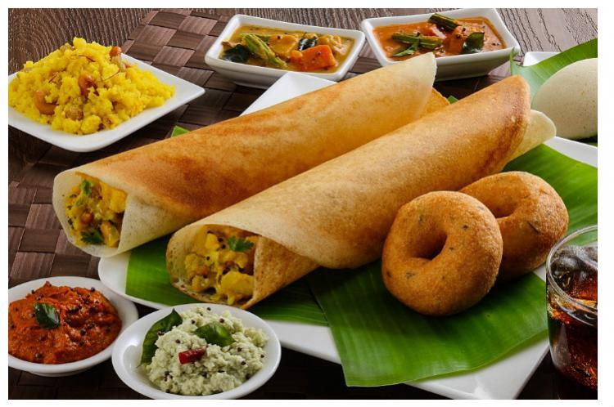
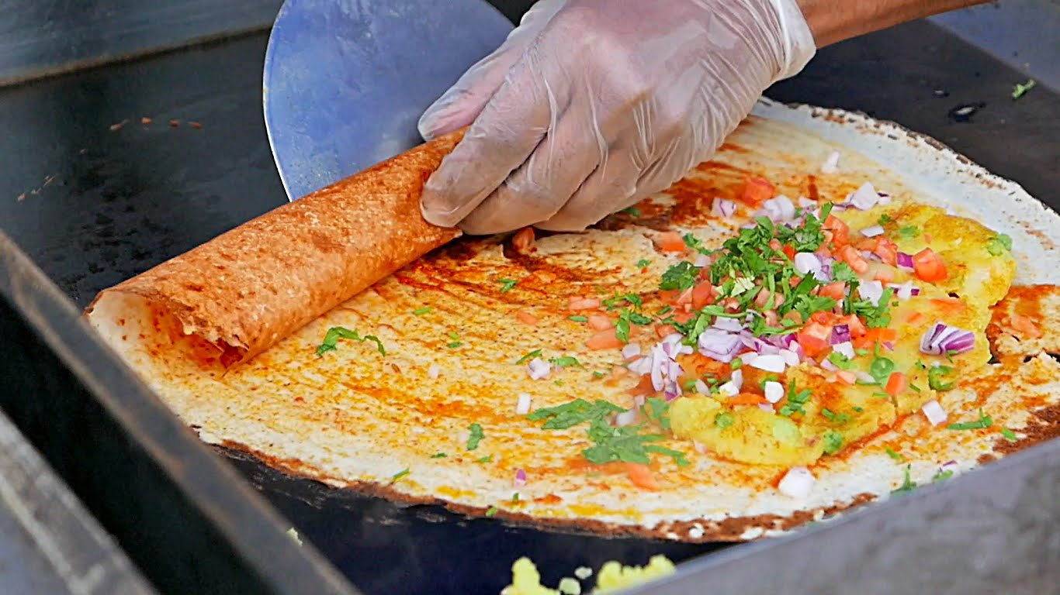
Dosa
-is a cooked flat thin layered rice batter,
originating from the Indian subcontinent, made from a fermented batter.
Its main ingredients are rice and black gram ground together in a fine, smooth batter with a dash of salt.

Slide 14
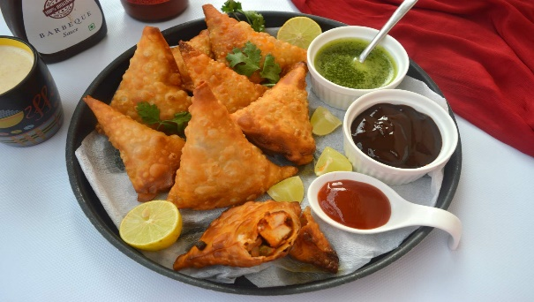
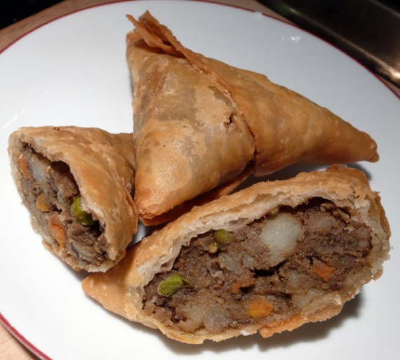
Samosa
is a fried or baked dish with a savory filling and may take different forms, including triangular, cone….
Ingredients
It is filled with spiced potatoes, onions, peas, meat, or lentils.

Slide 15
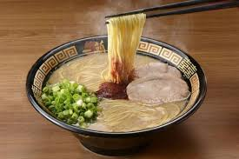
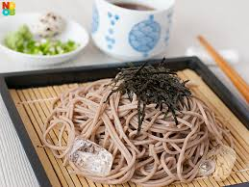
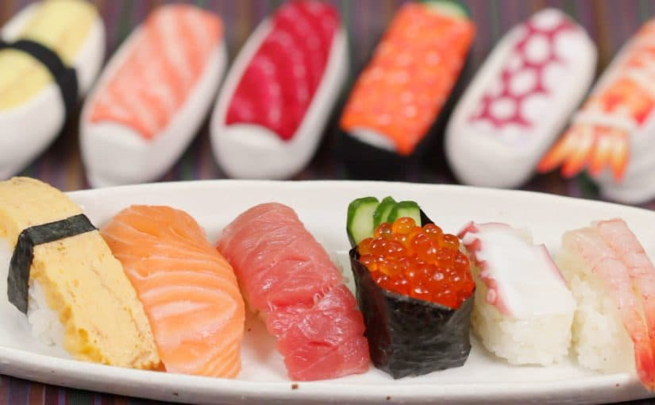
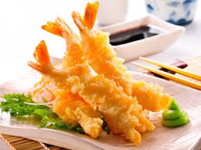
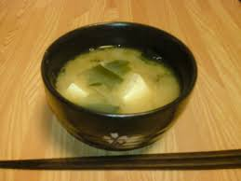
JAPANESE FOOD

Slide 16
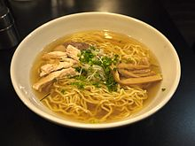
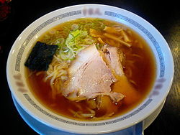
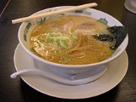
Ramen
Ingredients
Noodle,
Chicken or Pork soup
Boiled Egg
Nori
Some other toppings
Ramen means “pulled noodles”.
Originated in the early 1600s.
Popularity increased in 1900s.

Slide 17
sashimi
Two types of sashimi
Rich flavor & light flavor
beautifully prepared with colorful seafood
Best with sauce
-Sashimi means “pierced body”
It is
“raw sliced fish”

Slide 18
Sake
Sake brewers are called toji
Sake means “Rice wine”
-18-20% ABV

